Slide 1

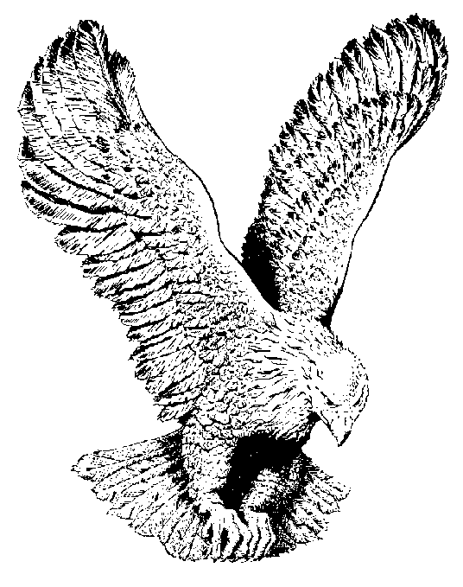
ISAIAH 51:11
Therefore the redeemed of the Lord shall return,
And come with singing unto Zion;
And everlasting joy shall be upon their head;
Therefore the redeemed of the Lord shall return,
And come with singing unto Zion:
And everlasting joy shall be upon their head.
They shall obtain gladness and joy;
And sorrow and mourning shall flee away.
Therefore the redeemed of the Lord shall return,
And come with singing unto Zion;
And everlasting joy shall be upon their head.

